Slide 1
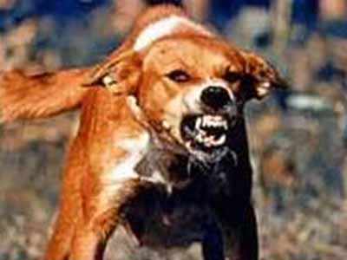
Rabies
By Brandon Longley

Slide 2
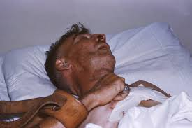
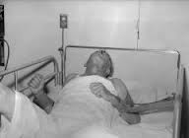
Symptoms when you have rabies
Fever confusion
Headache Hyperactivity
Nausea difficulty swallowing
Vomiting Anxiety
Confusion Agitation
Rabies causes Encephalitis witch causes inflammation of the brain.

Slide 3
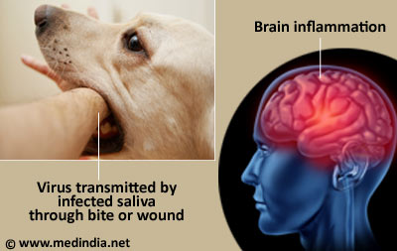
Causes in humans
Rabies is caused by a virus.
It is transmitted from animals to humans through saliva most commonly by animal bites.

Slide 4
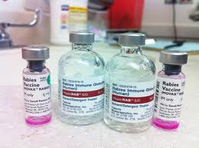
cures
The treatment for someone who has been exposed to rabies is a series of shots known as postexposure prophylaxis (PEP).
These shots help the body's immune system destroy the disease in its early stages.
fatal by the time the virus reaches central nervous system.

Slide 5
Other facts
Rabies causes about 55,000 human deaths annually worldwide.
95% of human deaths due to rabies occur in a Asia and Africa.
40% of people who are bitten by suspect rabid animals are children under 15 years of age.

Slide 6
video
Rabies

Slide 7
sources
http://www.nytimes.com/health/guides/disease/rabies/overview.html
http://www.medicalnewstoday.com/articles/181980.php
http://www.webmd.com/a-to-z-guides/rabies-topic-overview
http://en.wikipedia.org/wiki/Rabies
http://www.who.int/mediacentre/factsheets/fs099/en/

